Slide 1
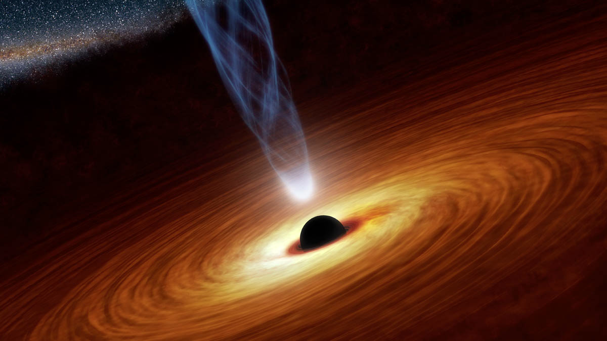
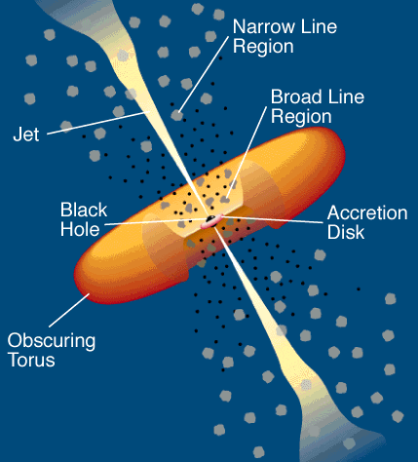
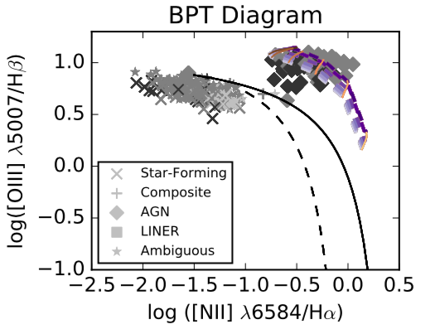
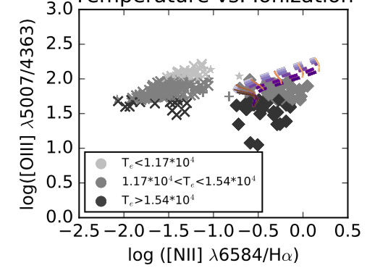
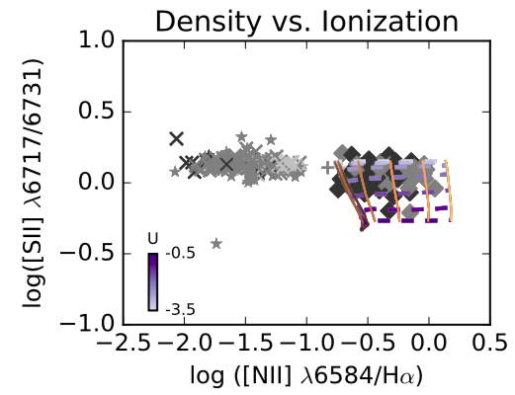
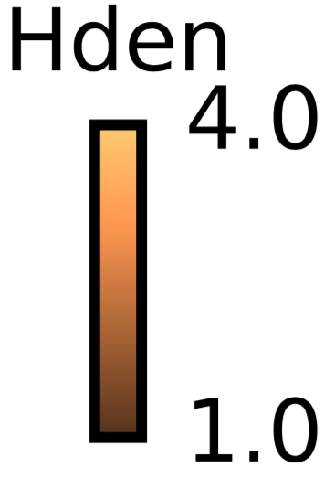
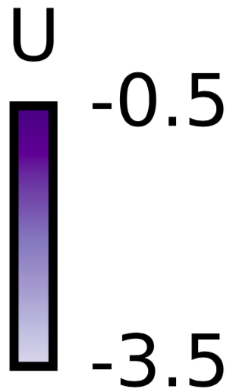
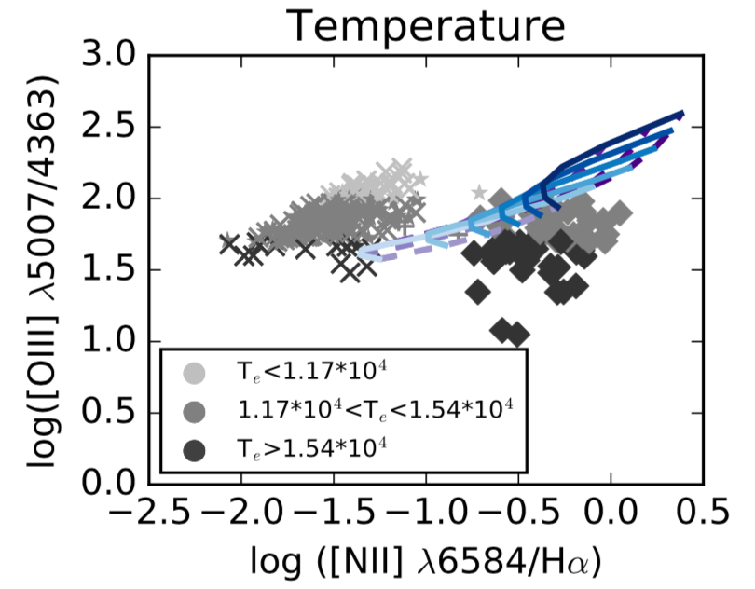
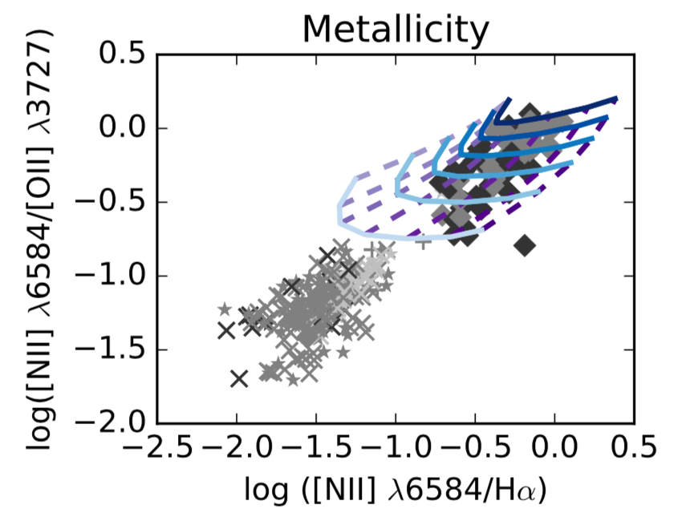
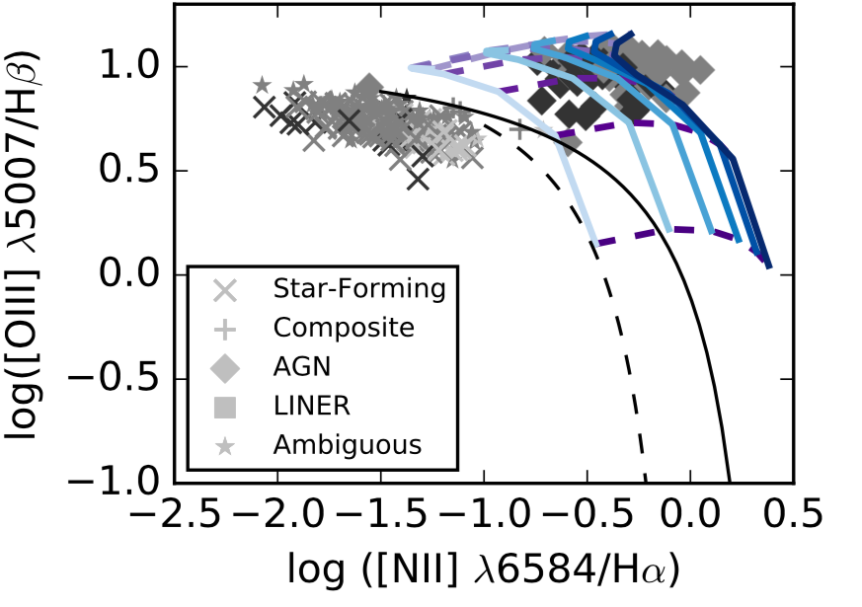
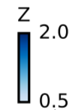
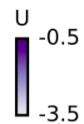
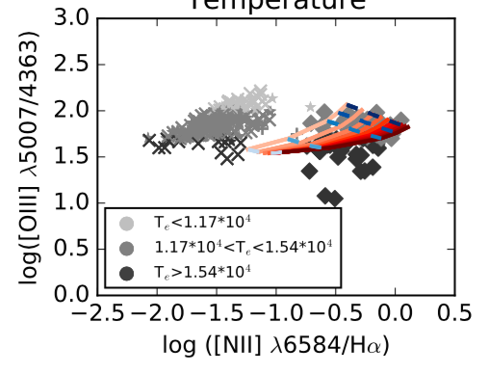
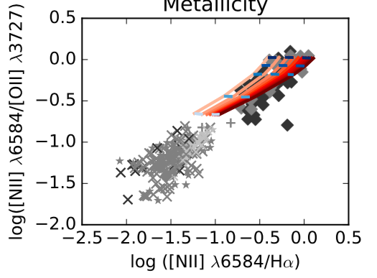
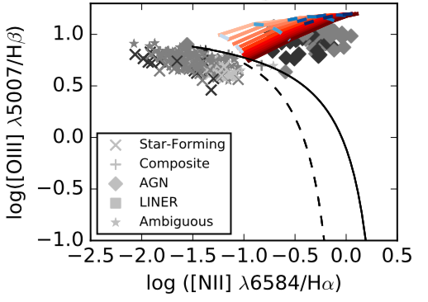
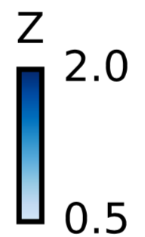
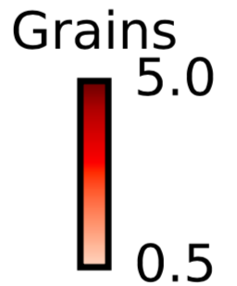
Investigating the Temperature Problem in Narrow Line Emitting AGN
Sam Jenkins, Chris T. Richardson
Elon University
sjenkins7@elon.edu (SJ), crichardson17@elon.edu (CTR)
Introduction
Results
Anomalously high electron temperature, T_{e}, in gas clouds around Narrow Line AGN
Decades old problem, but previous attempts at simulating high temperature AGN outliers have been unsuccessful, hence the “temperature problem” (Richardson et al. 2014)
We use a program called CLOUDY to simulate gas clouds and output emission lines when given various input parameters (Ferland et al. 2013)
This research aims to explain the physical conditions necessary for anomalously high T_{e} in AGN
BPT Diagrams
Temperature Diagnostics
Other Diagnostics
Methods
Data
Original data set of 200,000 galaxies from Sloan Digital Sky Survey filtered to 469 by S/N [OIII] 4363 > 5.0 and 0.04 < z < 1.0 (Albareti et al 2015)
Plot this data on diagnostic diagrams to investigate properties such as T_{e}, hydrogen density (n_{H}), metallicity (Z), ionization parameter (U)
Previous research was used to classify galaxies by type according to emission line ratios (Kewley, Groves, Kauffmann, Heckman, 2006)
Simulations
Use CLOUDY to simulate clouds in the narrow line region of these galaxies
Simulations run on SDSC Comet cluster, which cut run time from 24 hours to 30-45 minutes
Vary Z, U, n_{H}, and grain abundance because of their effects on T_{e} and ionization, one at a time
Constant pressure and grain composition maintained throughout all simulations, and sims stopped at n_{e}/n_{H} = 0.01
Median spectral energy distribution values were determined from Grupe, Komossa, Leighly, Page, 2010, including ⍺_{ox} = -1.42, ⍺_{uv} = -0.57, and ⍺_{x} = -1.63
Find reasonable ranges of values for each parameter with help from literature (Osterbrock & Ferland 2006, Groves, Dopita, Sutherland, 2004)
Adjusting simulation parameters to cover high T_{e} AGN on all plots
BPT separates AGN from star forming, etc. (Baldwin, Phillips, Terlevich, 1981)
n_{H} vs. U and Z vs. grains sims miss large portion of high temperature AGN on BPT Diagram while Z vs. U sims match almost all
Most high temperature AGN show 0.6 < Z/Z < 1.2 with grain content > 2.0
[O III] 5007/4363 separates galaxies into temperature categories with highest temperature at lowest ratio
Varying grain abundance produces highest temperature while maintaining [NII]6584/H⍺ ratio
High temperature Z vs. U sims miss high temperature AGN
High grain content and low Z produces highest temperatures due to decreased cooling effect and increased photoelectric heating
n_{H} vs. U and Z vs. U sims match almost all AGN which validates our chosen parameter values
Grains vs. Z sims match most AGN but miss some high temperature AGN
References
Future Work
Baldwin, J., Phillips, M., Terlevich, R., 1981, PASP, 93, 5-19
Richardson, C., Allen, J., Baldwin, J., Hewett, P., Ferland, G., 2013, MNRAS, 437, 2376
Kewley, L., Groves, B., Kauffmann, G., Heckman, T., 2006, MNRAS, 372, 961
Groves, B., Dopita, M., Sutherland, R., 2004, ApJ, 153, 75
Grupe, D., Komossa, S., Leighly, K., Page, K., 2010, ApJ, 187, 1
Osterbrock, D., Ferland, G., 2006, Astrophysics of Gaseous Nebulae and Active Galactic Nuclei
Albareti et al., 2015, arXiv: 1501.00963
Ferland et al., 2013, arXiv: 1302.4485
Acknowledgements
Conduct statistical analysis of results to determine how much of our high temperature AGN are matched by sims
Begin adjusting free parameters such as cosmic rays or turbulence to achieve higher temperatures through extra heating
This project was done as part of Elon University’s Summer Undergraduate Research Experience, Summer 2017. I would like to thank Elon University’s Undergraduate Research Program and my research mentor, Dr. Chris Richardson. This project was conducted with support from XSEDE grant TG-AST140040.

